Slide 2

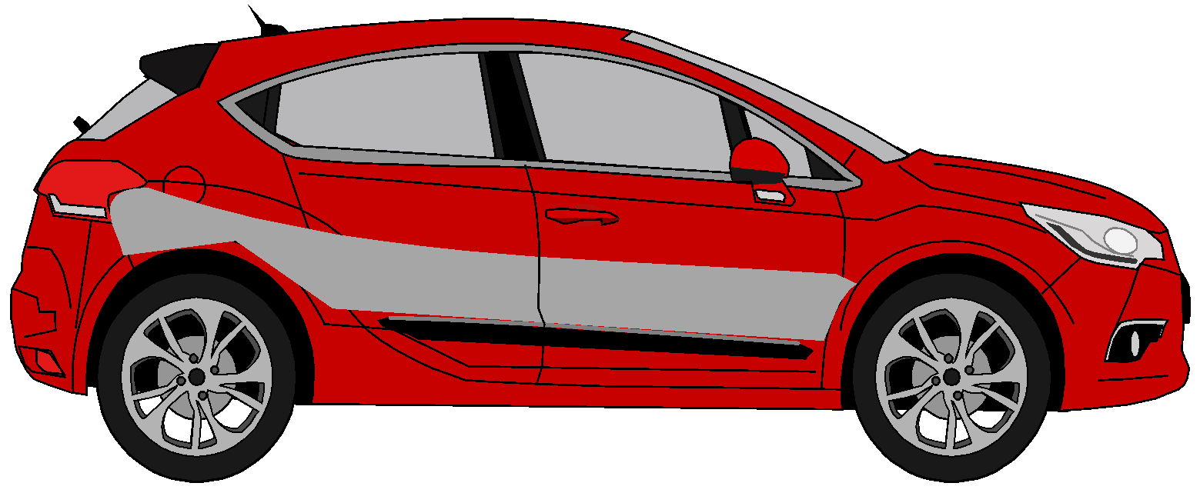
Project Demo – Boltcarz PSI – 2022 JUN ASDE Batch 4
October 3, 2022

Slide 3
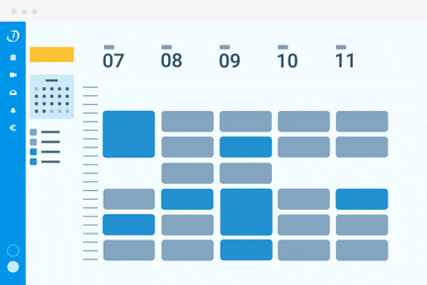
Agenda
PS Journey​
Problem Statement
Project Management
Agile Methodology
Tech Stack & Architecture​
Jenkins Pipeline​
Application Demo ​
NFRs
Reports & Documentation
Future Scope
Conclusion​
Q & A​

Slide 4
Learning Phase
Goal:
Learn by doing
Learn by observing
Learn by sharing
Week 01
Week 02
Week 03
Week 04
Week 05
Java
Database
Backend
Frontend
Deployment
Java, Dev Ops – Git
RDBMS, Postgres, JSP & JDBC
Spring Core & Boot,
Microservices, Swagger REST, MVC, Netflix OSS, Junit & Mockito,
UI – HTML, CSS, JS, TS, React
AWS, Docker, CI/CD, Jenkins

Slide 5





Product Phase
Sprint 0
Sprint 2
Sprint 4
Sprint 6
Environment Setup
Choose your Car
Build Your Car (Interior)
Improvements & Optimizations
Start
Final Demo
10th Aug
3rd Oct
Test Drive Flow
Build Your Car (Exterior)
Delivery Functionality
Sprint 1
Sprint 3
Sprint 5
NFR's were covered throughout the product phase​

Slide 6
The Team

Slide 7
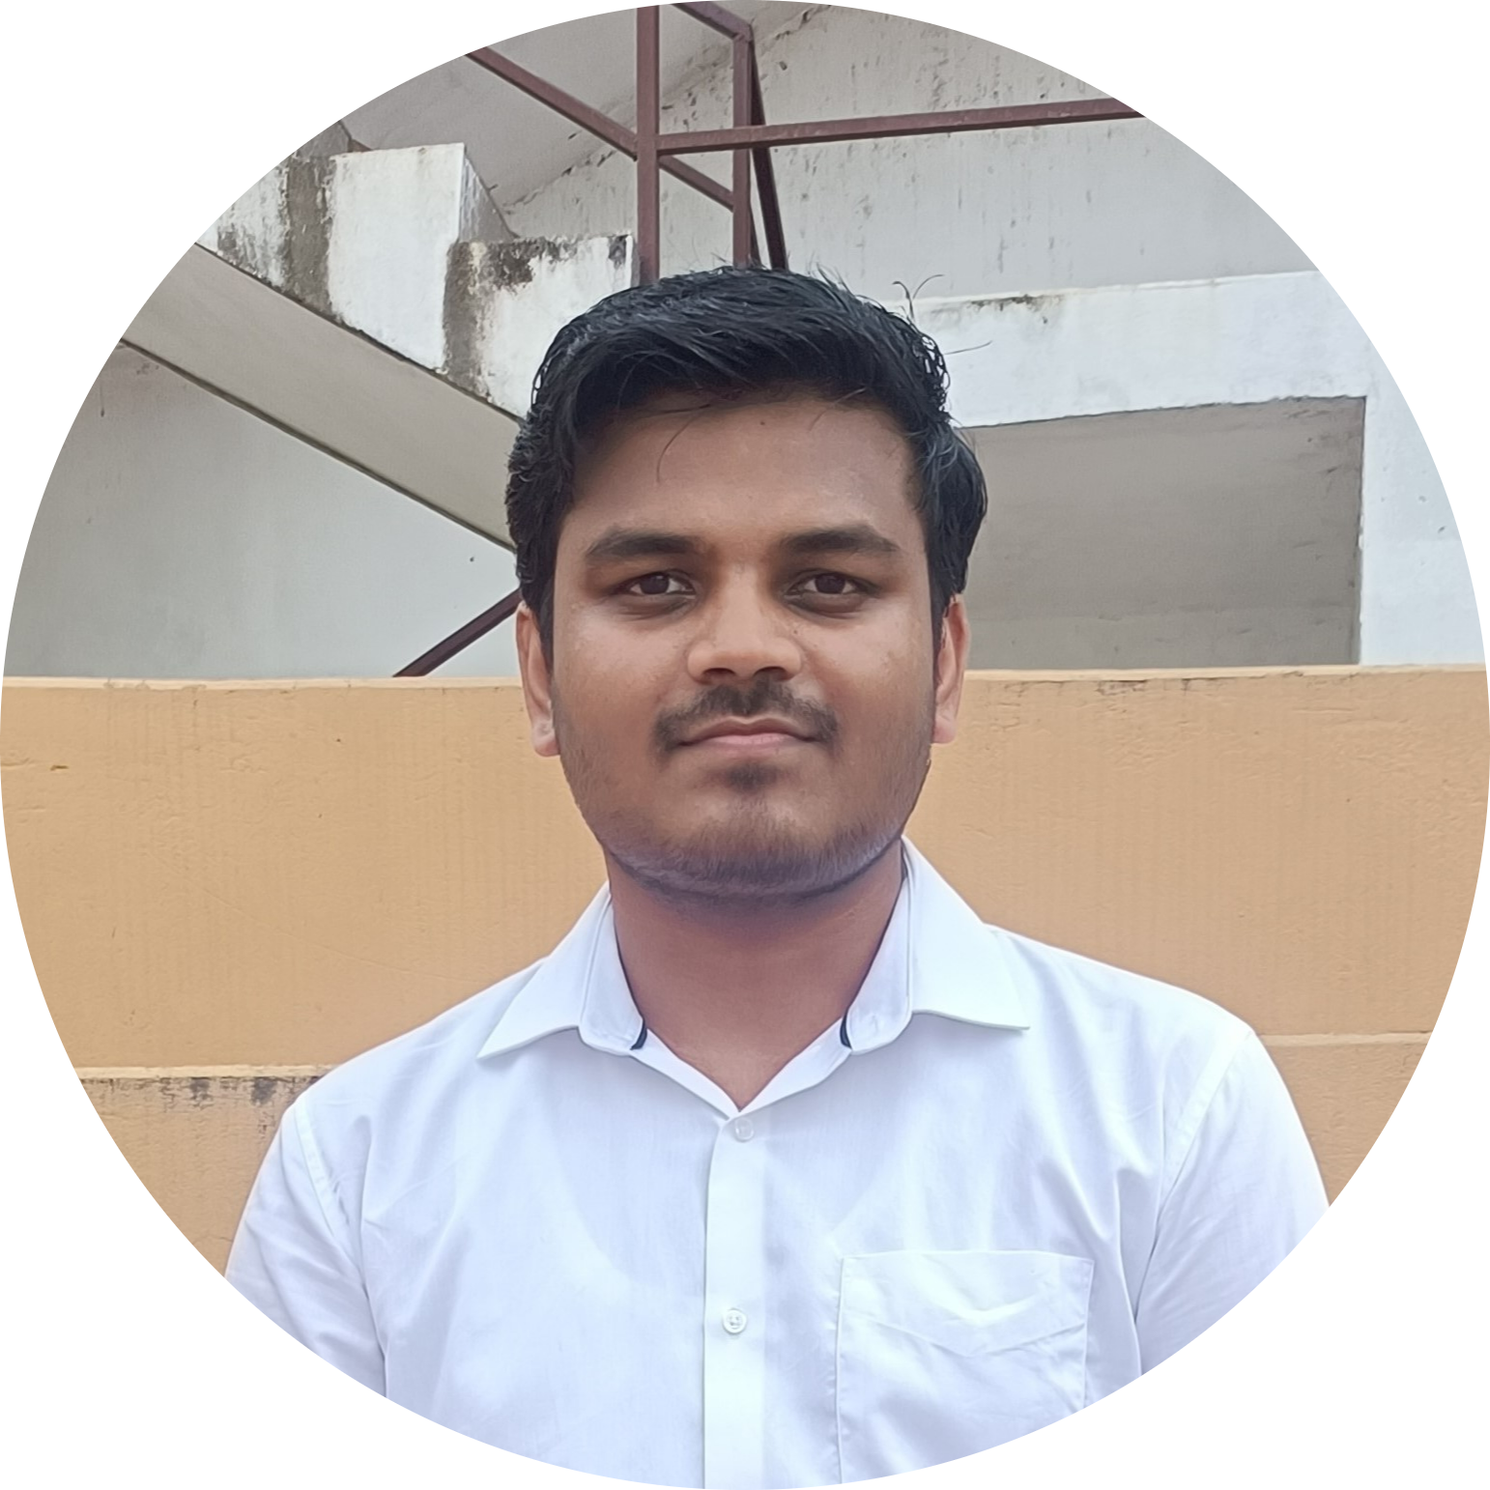
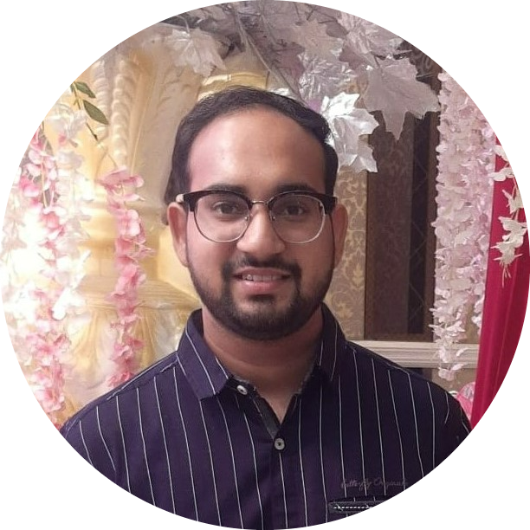
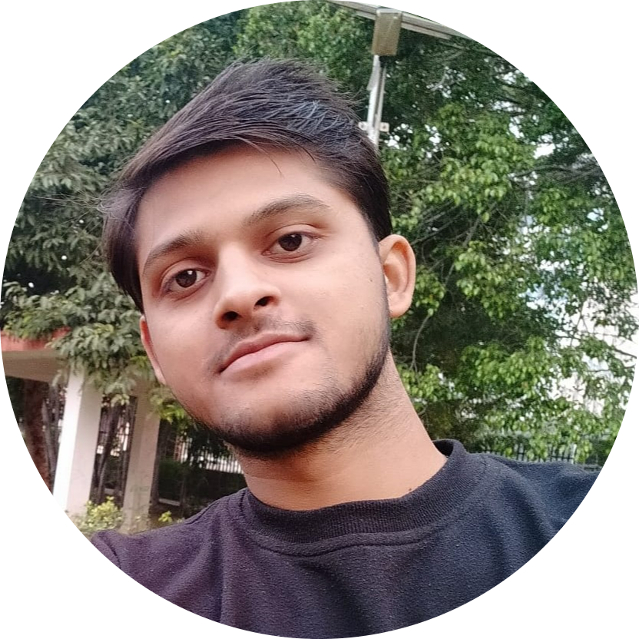

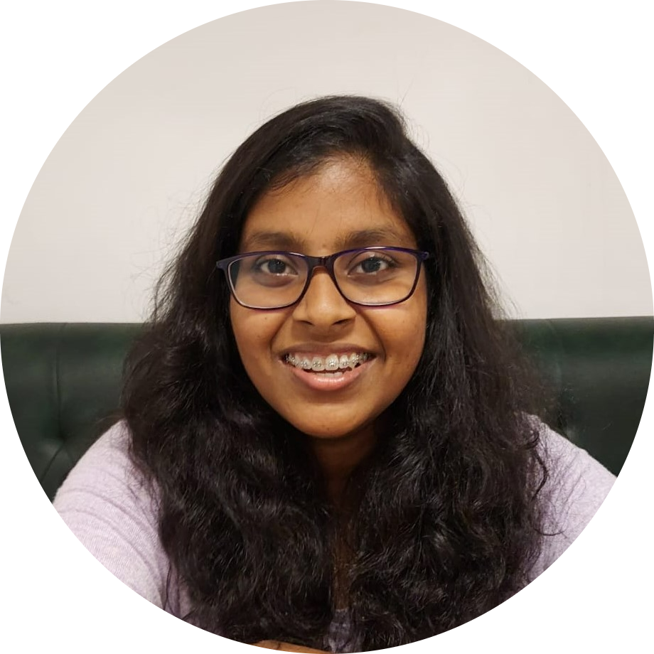
The Devlappars
Shubh Kriti Narayan
Ayush Goyal
Akshay Kushwaha
Suraj Jindam
Sharmila P

Slide 8
Problem Statement
Enabling the users to buy cars at their comfort and the freedom to customize and choose.
Making a user-friendly platform which enables registered users to buy the vehicle and a customer can browse through all the available models with variety of filters to sort them out.
Giving the privilege to the customer to book a test drive at their comfort and to customize the vehicle with variety of options and by providing different payment options thus giving financial freedom to the customer.

Slide 9
Tech Stack and Architecture

Slide 10










































Tech Stack
Frontend
Backend & DB
Testing
DevOps/ Monitoring
Cloud-AWS
T
PLT
Jest

Slide 11
Flow Diagram

Slide 12
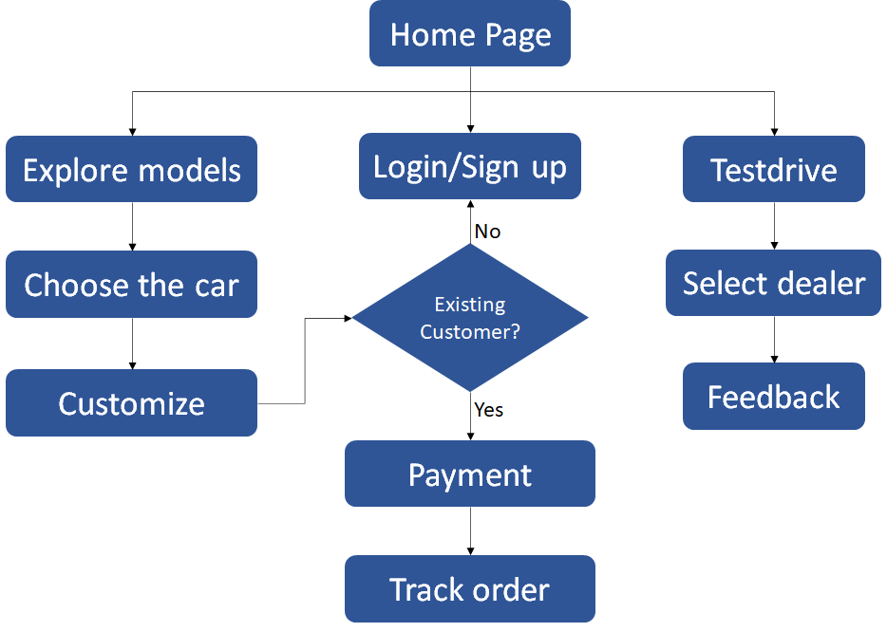
Customer Flow Diagram

Slide 13
Backend Architecture

Slide 14
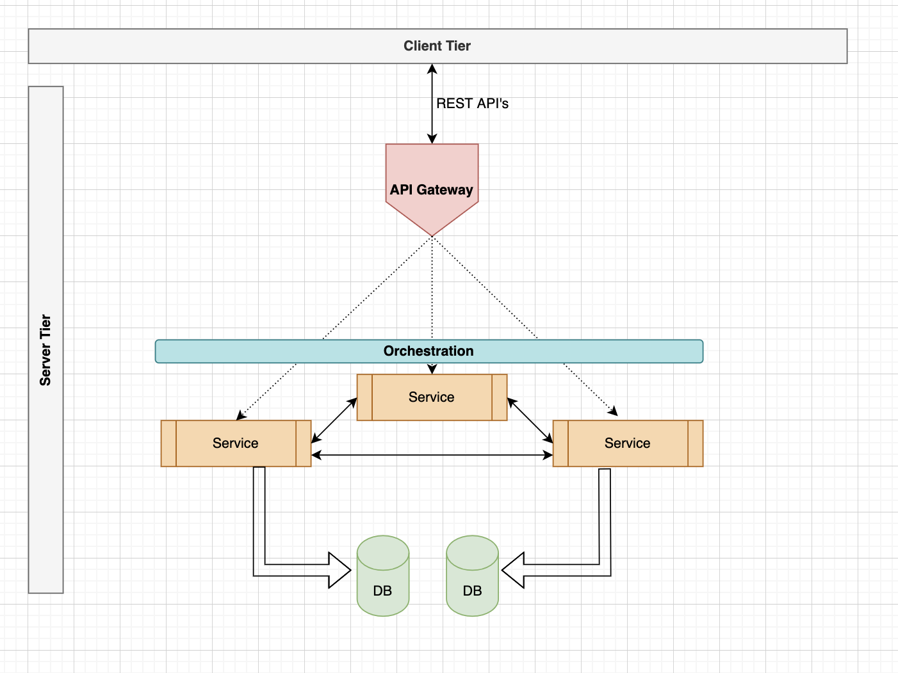
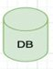
Backend Architecture Diagram

Slide 15
Frontend Architecture

Slide 16
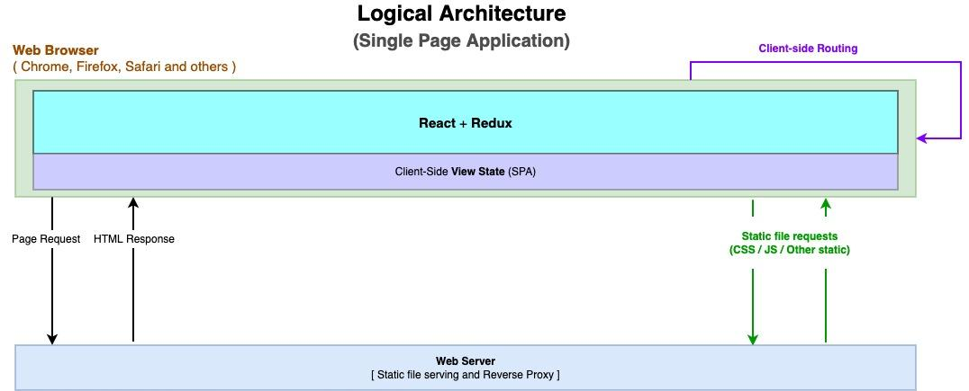
Frontend Architecture Diagram

Slide 17
Application Features
Test-drive the car
Choose your car
Build / Customize your car
Opt for Finance Options
Buy the car
Track the delivery of your car

Slide 18
Application Demo
https://boltcarz.com

Slide 19
BOLTCARZ
PRODUCT DEMO
BOLT: CUSTOM CARS(BOLTCARZ.COM)

Slide 20
Future Scope
360° Car View
01
Security Improvements
02
After Sale Services
03
03
Dealer Portal
04

Slide 21
Conclusion

Slide 22
Challenges
Learning, grasping and implementing new tech stack simultaneously
Working with AWS services
Mistakenly deleted Jenkins instance of CI pipeline
Achieving the NFRs
Achieving optimal code coverage
​

Slide 23
Learnings
TECHNICAL
01
Java
09
DevOps
02
Microservices Architecture
10
Amazon Web Services
03
Data Encryption
NON-TECHNICAL
11
04
React
09
Agile Methodology
05
Atomic Structure
12
Collaboration
06
Security
13
Presentation Skills
07
14
09
Unit Testing
Email Etiquette
08
Code Quality
15
Time Management

Slide 24
Testimonials

Slide 25
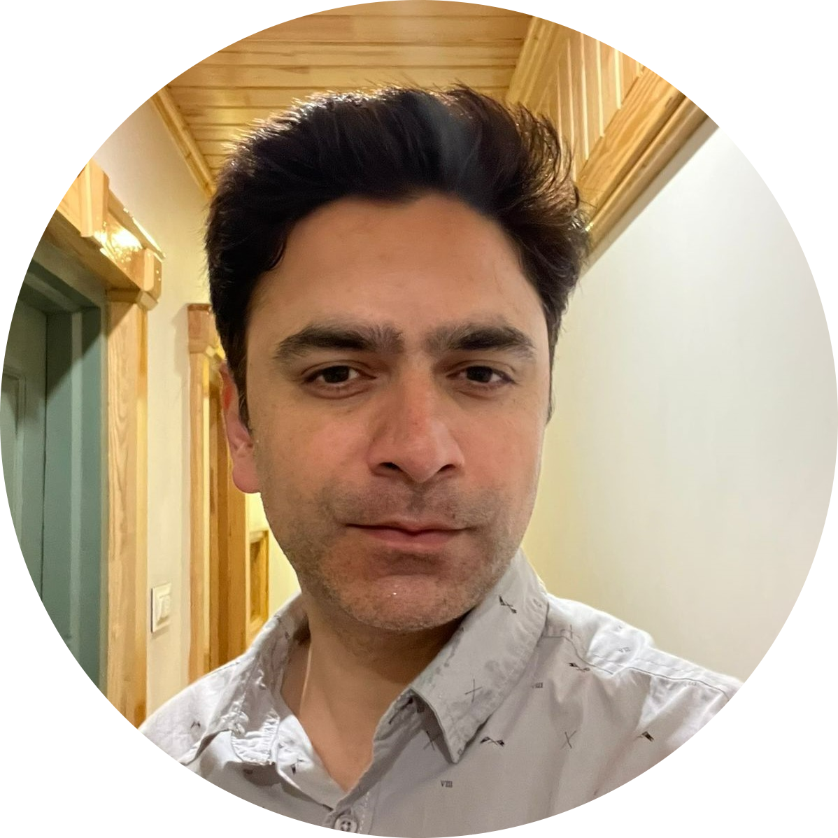
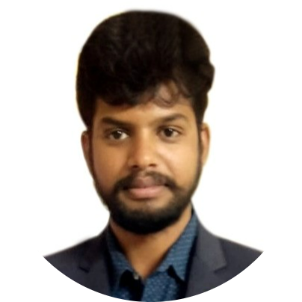
Trainer Testimonials
Waleed Qureshi
Sharath Kumar
With the eagerness and determination, the folks showed from the start, I had a great time transferring my knowledge over to them. They certainly played their part in the training by making the sessions interactive and making it a success overall. It’s a great time to be a Full stack developer and I can’t wait for them to start doing what I found them capable of.
I want to take the time to look back on a truly awesome training session that I had the pleasure of meeting during my time teaching with your team and make more productive interactive. It was a great job done and I really like the involvement of each participant in the production environment .I am glad that I am lucky to have these participants and thanks to Publicis sapient team always supportive .Best Luck for your future endeavors

Slide 26
Thank You

